Slide 1
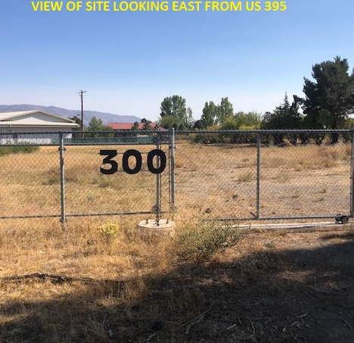

AMUNDSON ROOFING special use permit
Washoe county board of adjustment
December 3, 2020

Slide 2
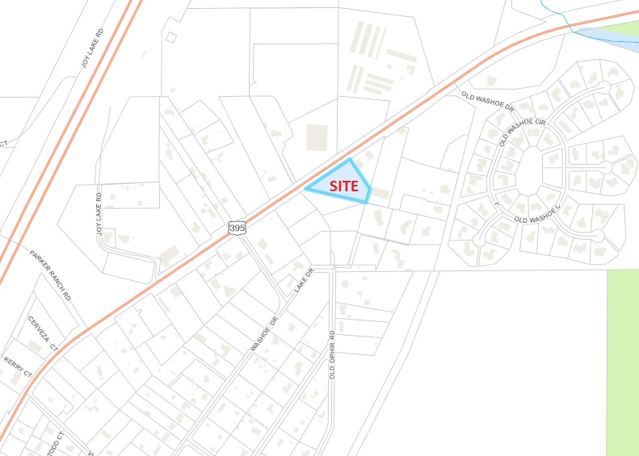

Project location
300 S. OLD US 395 (SOUTH SIDE OF HIGHWAY, WEST OF EXITING GAS STATION)

Slide 3

Project request
The following request has been made to Washoe County:
A Special Use Permit to allow for the establishment of a Construction Sales and Service use within the Old Washoe City District.

Slide 4
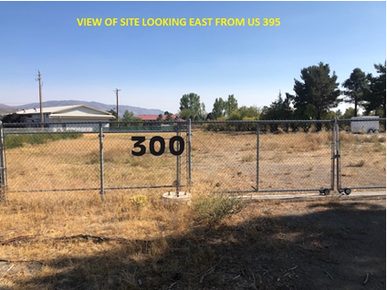
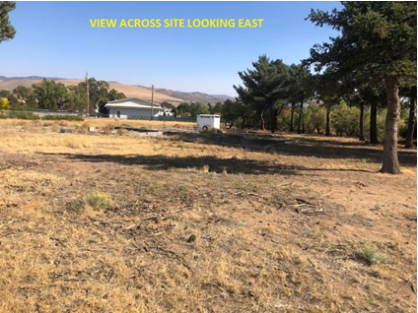
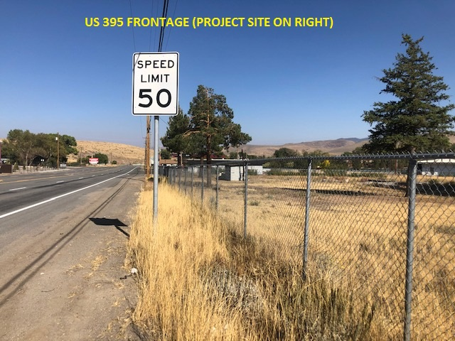
EXISTING CONDITIONS
Currently vacant

Slide 5
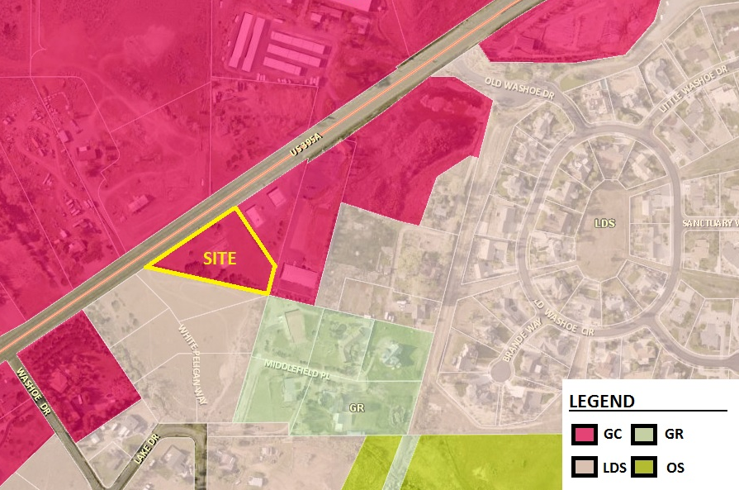
ZONING

Slide 6

PROJECT
SUMMARY
Amundson Roofing wishes to establish their headquarters onsite.
14,410± sq.ft. including 1,941 sq.ft. of office space and 12,469 sq.ft. of shop/warehouse area.
Project will access from the existing gate at northern portion of site.
Building is located away from residential uses. No windows will face existing homes.
Building design is similar to existing uses (i.e. dispensary immediately north).
4 to 6 employees onsite.
Business hours are 7:00 am to 5:00 pm Monday through Friday.
Low intensity use.

Slide 7
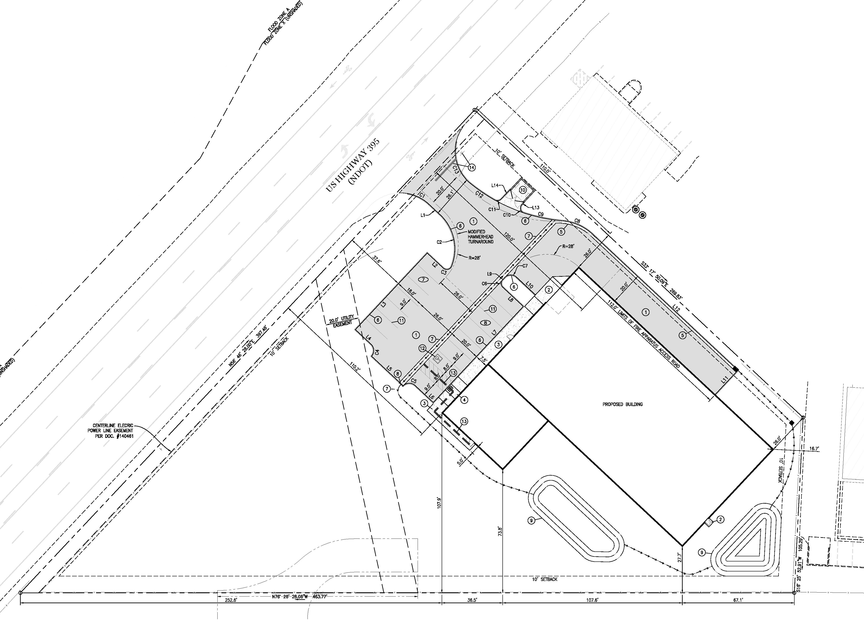
ZONING

Slide 8
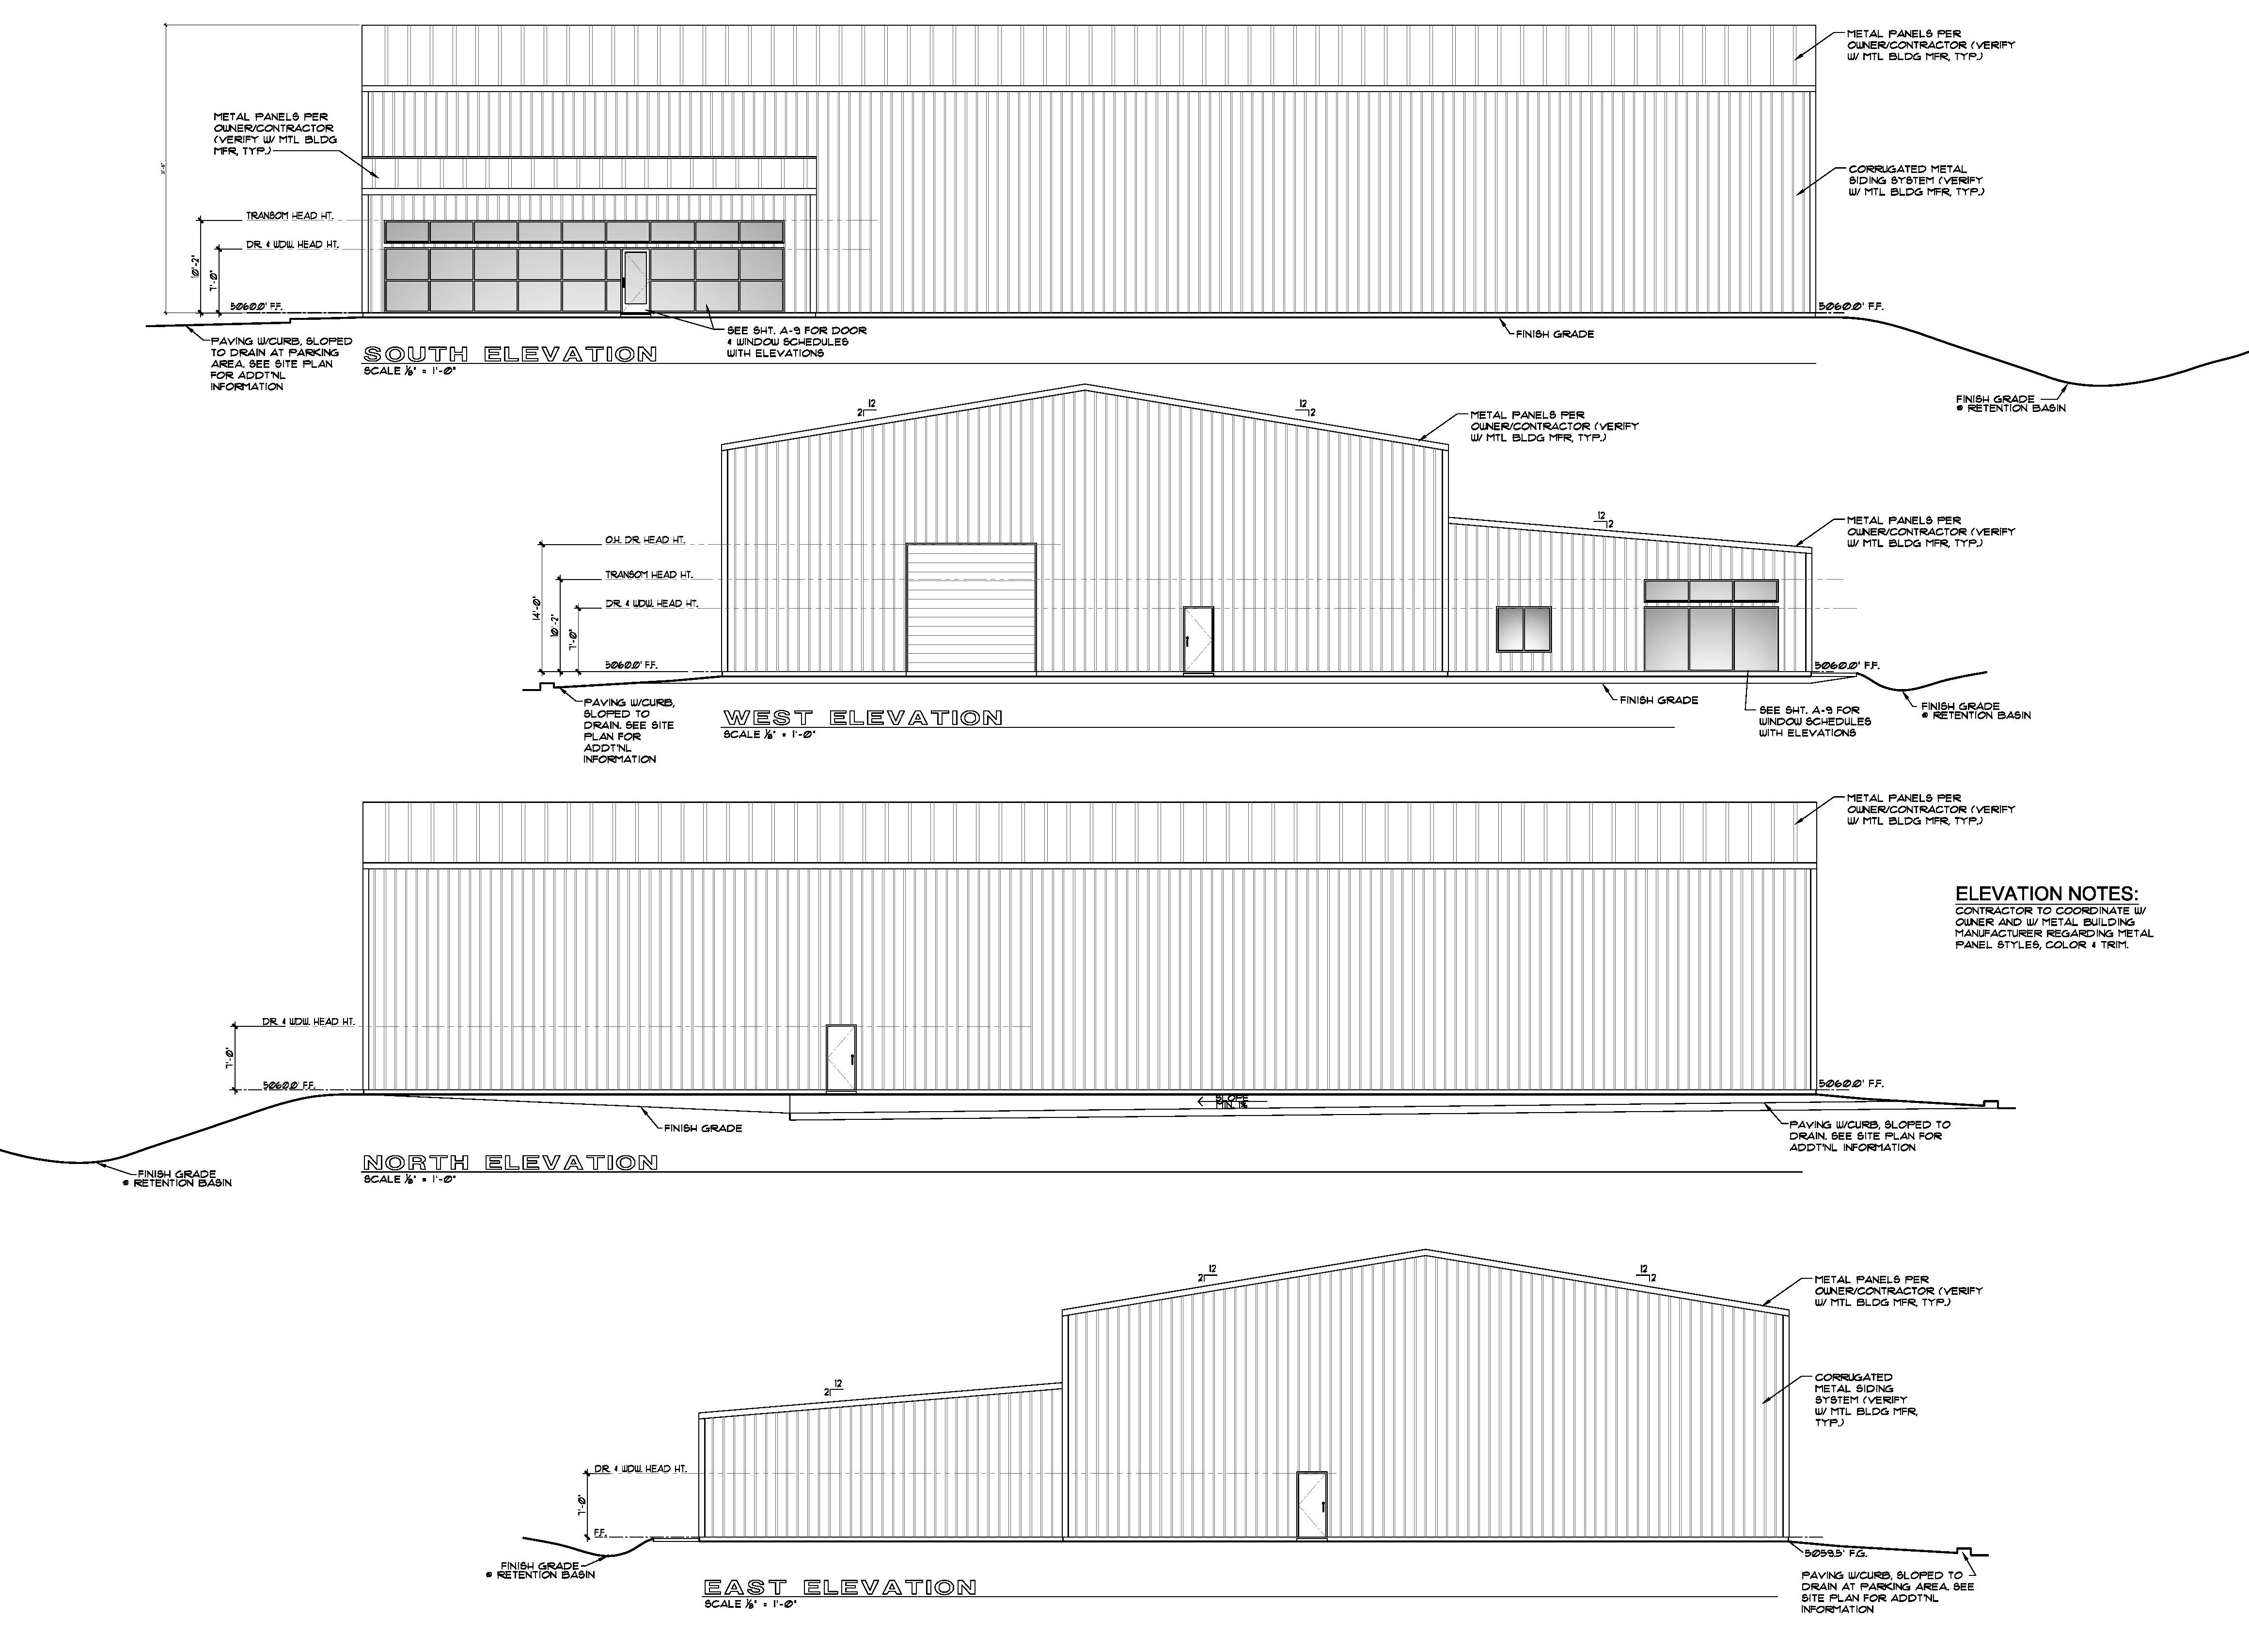
ZONING

Slide 9
PROJECT
CONSIDERATIONS
Consistent with existing zoning.
Protects the privacy of residential uses (existing and future).
Compatible with existing uses in the area.
Low intensity use.
All operations contained within building.
Minimal traffic (only 3 peak hour trips).
New landscape improvements along Old 395 frontage.
No outdoor storage or operations are proposed.

Slide 10

Mike Railey
Christy Corporation, Ltd.
(775) 250-3455
mike@christynv.com

